Slide 1



Generative AI with LLM
Florian Bastin
👨🏼‍🎓 Master MASH - Université PSL
👨🏼‍💻 LLM Engineer @OctoTechnology
Le Monde, Casino, Channel, Club Med, Pernod Ricard, Suez

Slide 2
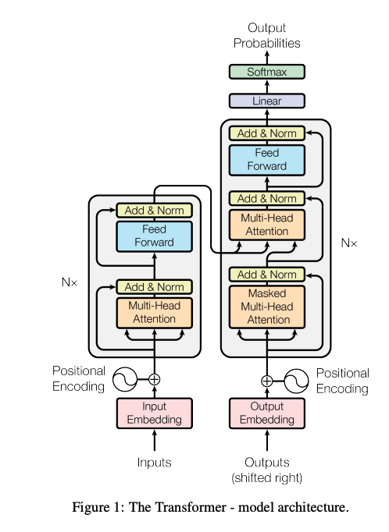
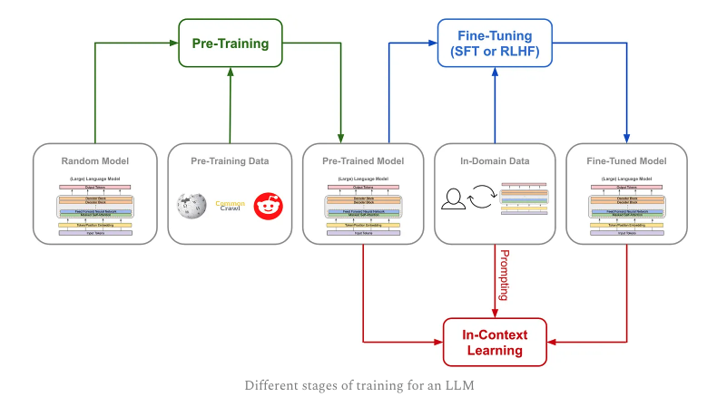
II. Transformers
Notes:
On a vu les différentes étapes d’entrainement d’un LLM comme GPT 3 mais on a pas vu l’architecture sous jacente.
On parlait de modèle à entrainer. Ajd on parle de Transformers

Slide 3
II. Transformers
A. Before Transformers
N grams
Embeddings
RNN
LSTM
B. Transformers
Self Attention / Cross Attention
Multi-Head Attention
Residual connection & Layer normalization
Feed forward layer
Softmax Layer
Positional Embeddings
Notes:
On a vu les différentes étapes d’entrainement d’un LLM comme GPT 3 mais on a pas vu l’architecture sous jacente.
On parlait de modèle à entrainer. Ajd on parle de Transformers

Slide 4
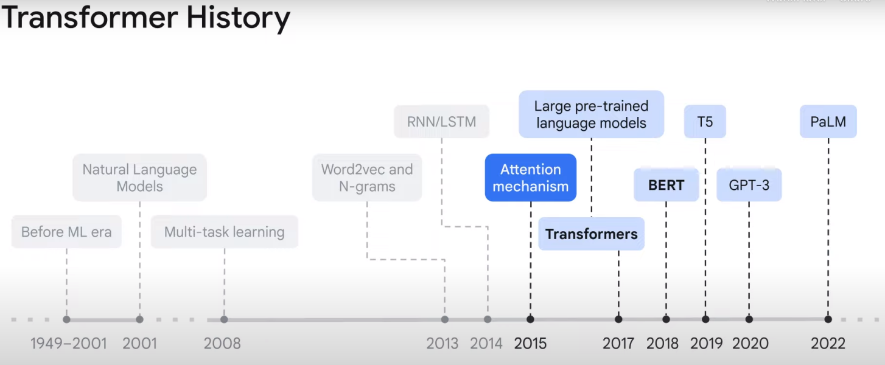
II.A. Before Transformers
A. Before Transformers
N grams
Embeddings
RNN
LSTM
The Story of AI Evolution: Before ML Era to Transformers, GPT-3 and Beyond [LinkedIn]
Notes:
On a vu les différentes étapes d’entrainement d’un LLM comme GPT 3 mais on a pas vu l’architecture sous jacente.
On parlait de modèle à entrainer. Ajd on parle de Transformers

Slide 5
II.A. Before Transformers
Our goal today
Input: “Transformers are encoder decoder”
Predict the word “models” from the input sentence
Requirements:
Find a way to transform word into numerical values
Provide semantic relationship between the encoding words
Provide context to our model to understand the sentence
Provide long context to our model to understand the sentence
Create a fast trainable model
Model
Predict: “models”

Slide 6
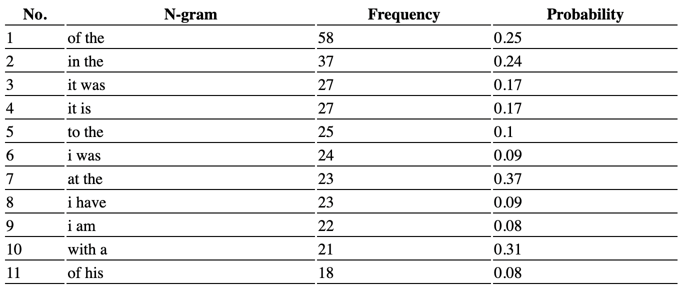
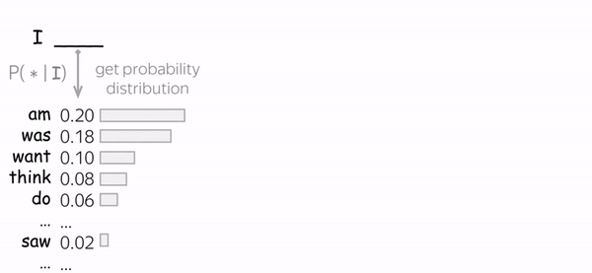
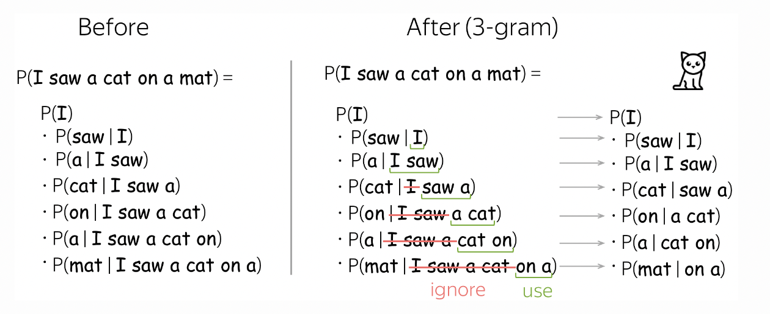
II.A.1 N Grams
The chain rule of probability: p(x₁, x,₂, …, x_{n}) = p(x₁) p(x₂| x₁) p(x₃| x₂,x₁) …
N Grams
Input text:
To Sherlock Holmes she is always the woman. I have seldom heard him mention her under any other name. In his eyes she eclipses and predominates the whole of her sex. It was not that he felt any emotion akin to love for Irene Adler. All emotions, and that one particularly, were abhorrent to his cold, precise but admirably balanced mind. He was, I take it …
Lena Voita, Language Modeling [Blog]
N-gram generator
Notes:
NGrams Limitation:
Finite context windows
High computational demande when N and data size increase
Data Sparsity

Slide 7
II.A.2 Embeddings
Our goal today
Input: “Transformers are encoder decoder”
Predict the word “models” from the input sentence
Requirements:
Find a way to transform word into numerical values
Provide semantic relationship between the encoding words
Provide context to our model to understand the sentence
Provide long context to our model to understand the sentence
Create a fast trainable model
Model
Predict: “models”

Slide 8
II.A.2 Embeddings
From One-hot encoding to Word Embedding
One-hot encoding
Word Embedding
Index | Mot
0 | a
1 | the
2 | he
… | …
1280 | transformers
1281 | embedding
1282 | partial
… | …
34567 | tunis
34568 | dolphin
One-hot encoding
Dim = |Vocab Size|
Semantic representation
Dim = |Chosen embedding size|
0
0
0
:
1
0
0
:
0
0
-0.81
:
:
:
4.56
:
:
:
-4.35
2.21
Embedding model
“transformers”
Index: 1280

Slide 9

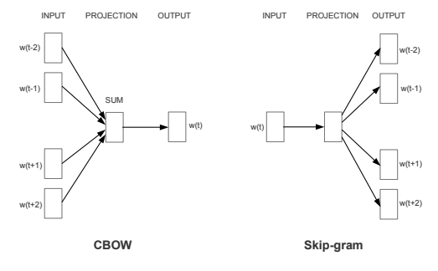
II.A.2 Embeddings
Word Embedding (Word2Vec, GloVe, BERT, ELMo)
Represent each word as a vector of numbers
Convert a discrete representation to continuous, allowing:
More ‘fine-grained’ representations of words
Useful computations such as cosine / euclidean distances
Visualization and mapping of words
Tomas Mikolov, 2013, Efficient Estimation of Word Representations in Vector Space

Slide 10
II.A.3 RNN
Our goal today
Input: “Transformers are encoder decoder”
Predict the word “models” from the input sentence
Requirements:
Find a way to transform word into numerical values
Provide semantic relationship between the encoding words
Provide context to our model to understand the sentence
Provide long context to our model to understand the sentence
Create a fast trainable model
Model
Predict: “models”

Slide 11
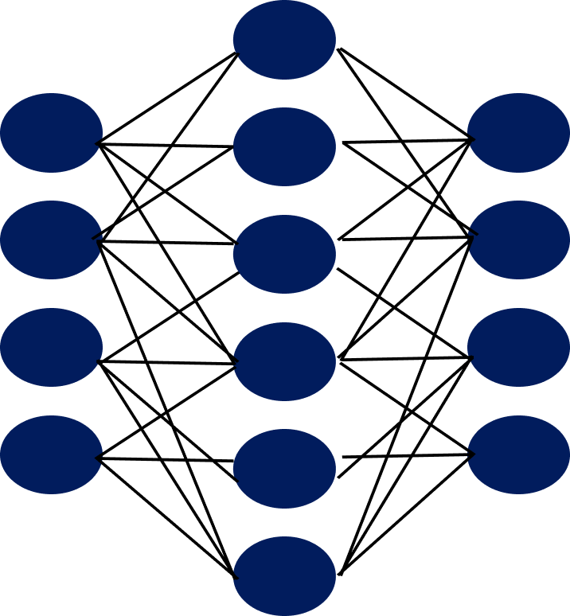
II.A.3 RNN
How to give a sentence to a model ?
Semantic representation
Dim = |Chosen embedding size| = 100
1
-0.81
4.56
:
-4.35
2.21
2
Embedding model
D
2 ≠1
“transformers”
-0.81
4.56
:
-4.35
2.21
-0.81
4.56
:
-4.35
2.21
⛔
D
D
-0.02
2.36
:
-1.12
3.13
Embedding model
“are”
D

Slide 12
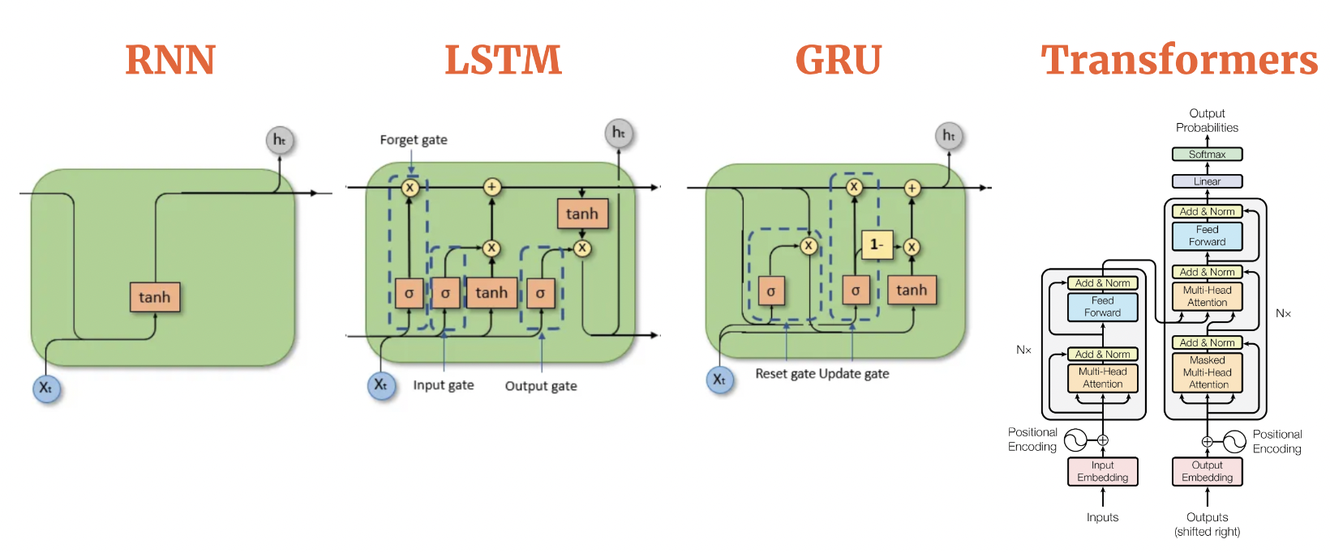
II.A.3 RNN
Seq2seq model

Slide 13
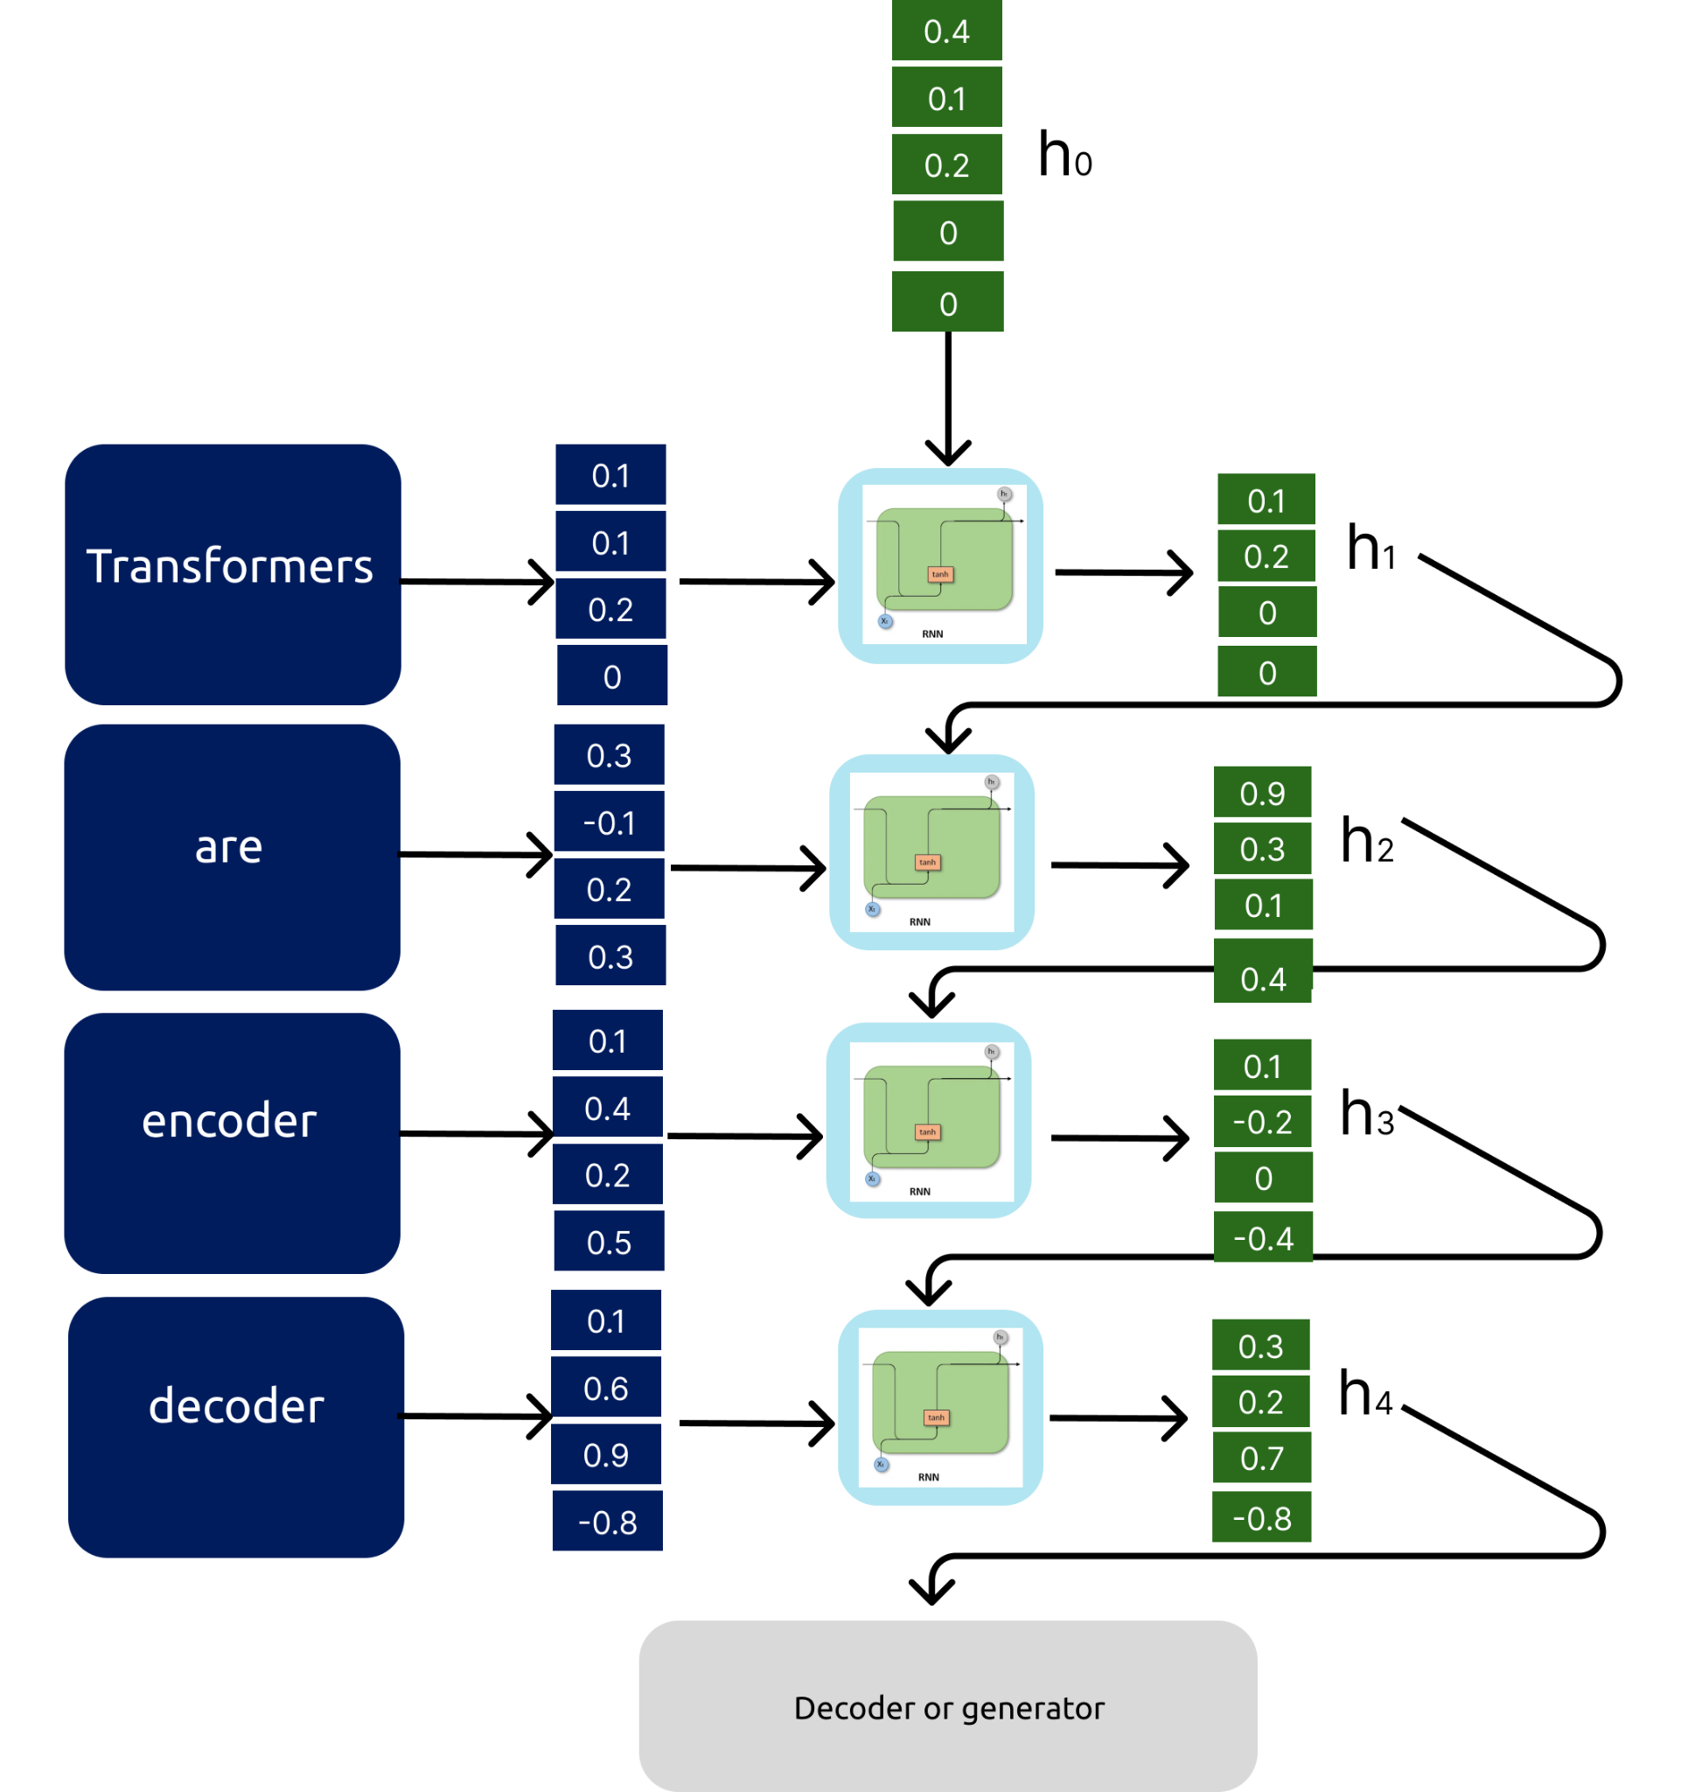
II.A.3 RNN
Recurrent Neural Networks (Sequential Model)
Advantages:
Can learn from context of previous word
Self supervised learning model
Problems:
Sequential model
Very short term memory

Slide 14
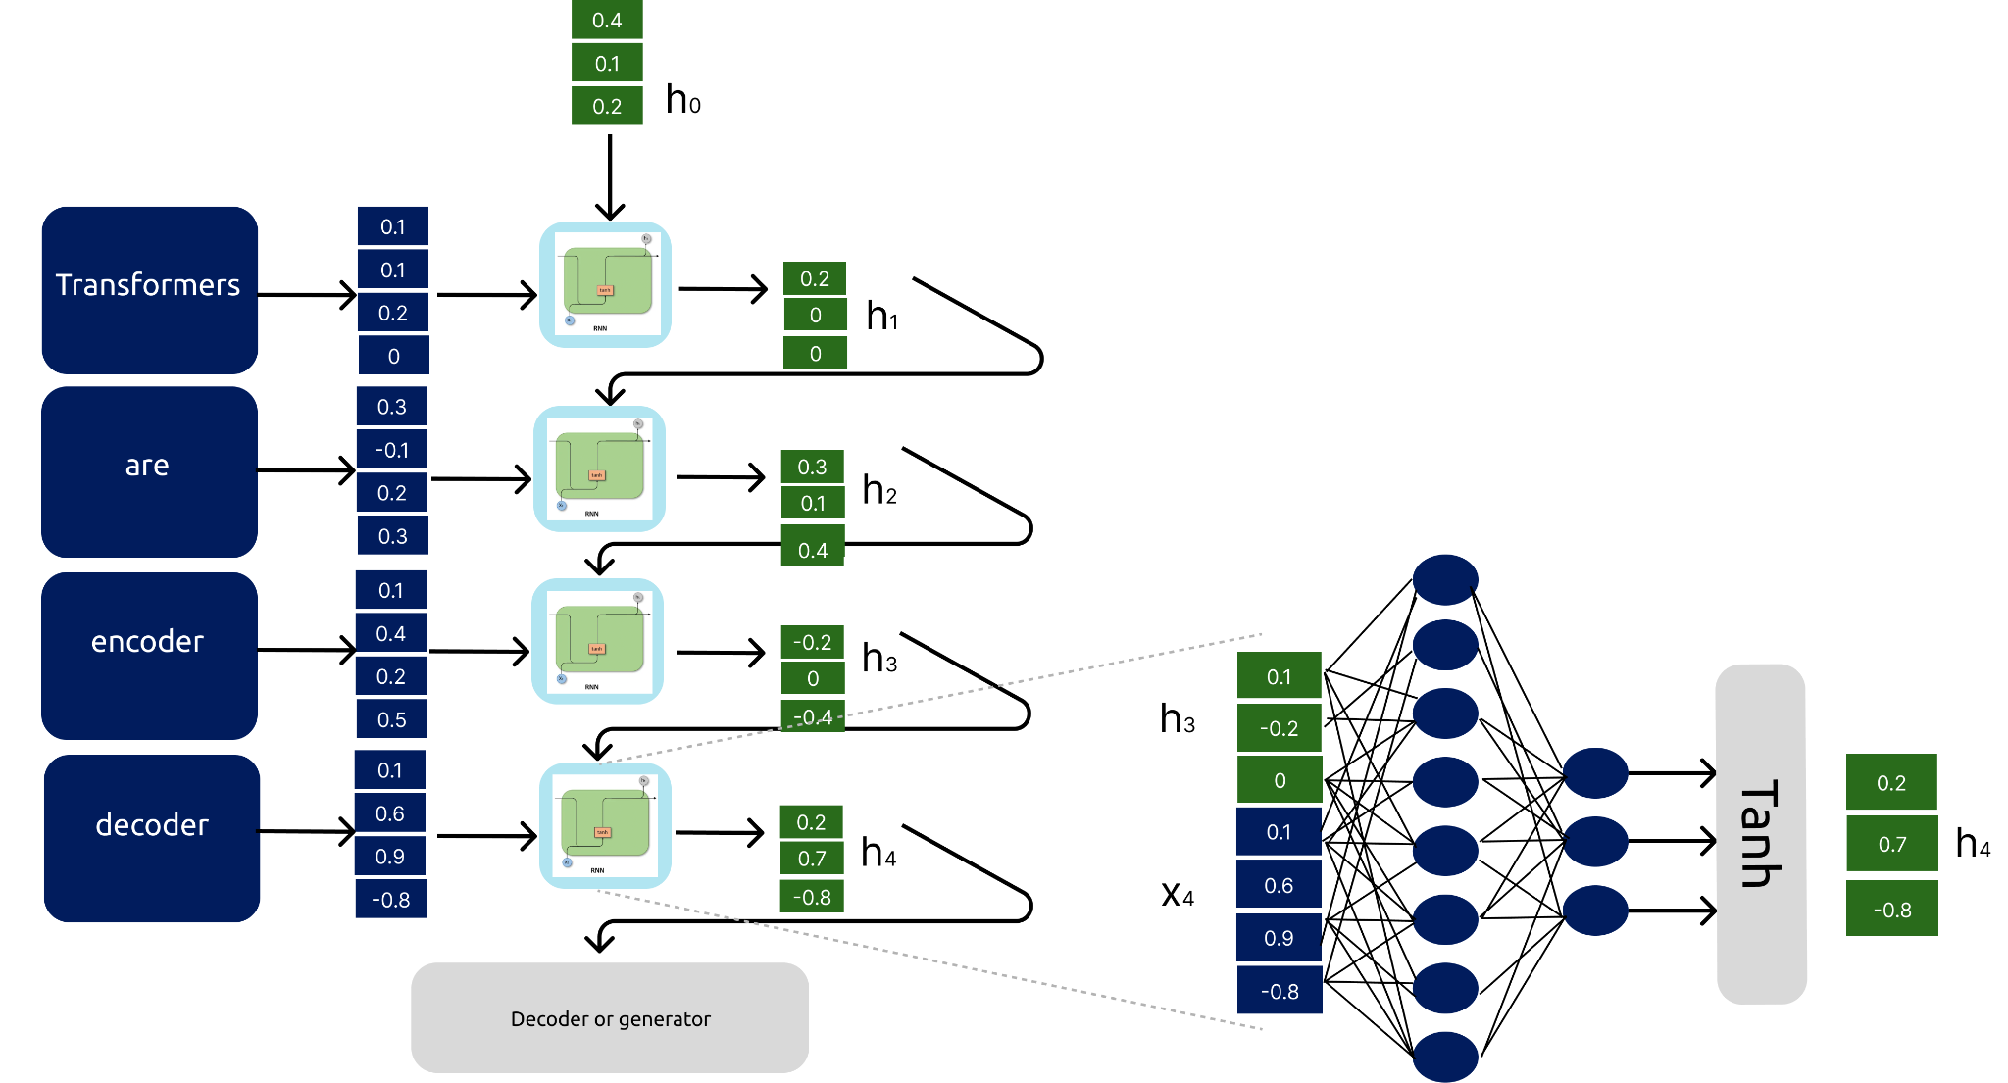
II.A.3 RNN
Recurrent Neural Networks (Seq2seq model)

Slide 15
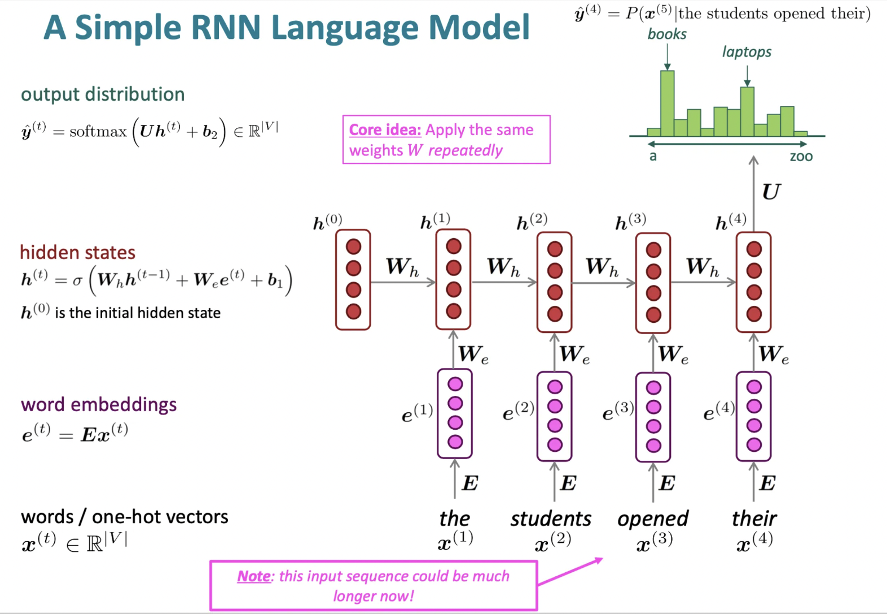
II.A.3 RNN
Recurrent Neural Networks (Seq2seq model)
Each word is given sequentially (x_{t})
An intern memory is updated after each word (h_{t})
A context is provided with this memory
Briefly describe the architecture of a RNN [Blog]

Slide 16
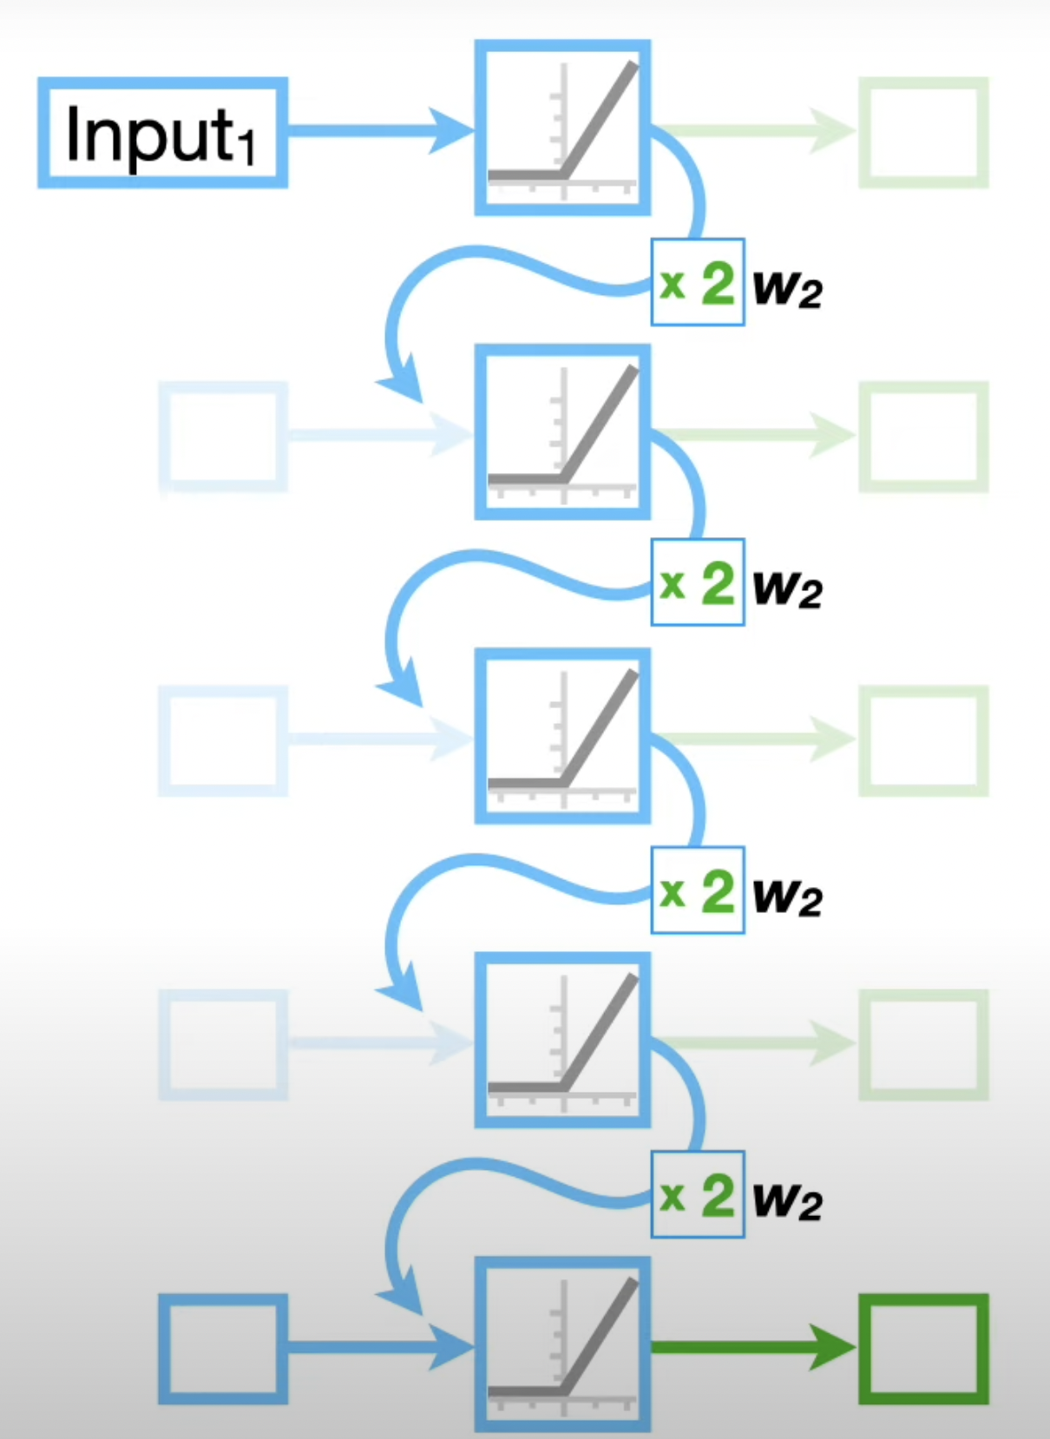
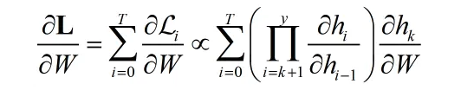
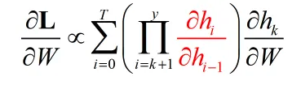
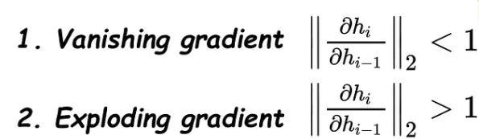
II.A.3 RNN
RNN limitations: Exploding / Vanishing gradient problem
“The”
Optimizing the loss w.r.t weights:
“transformers”
“are”
“encoder”
“decoder”
“Models” ?
D. Barack Ore, 2020, The Exploding and Vanishing Gradients Problem in Time Series
StatQuest with Josh Starmer [Youtube]
Notes:
W2 = 2
Input x 2 x 2 x 2 x 2 par couche
Input x 16
Quand on met a jour les poids en backpropagation, les poids recoivent un update proportionnel au gradient with respect to le current poid du timestep
Pour les permiers mots dans notre cas, les poids recoivent un update des tous les poiuds supérieur, à savoir une grosse value.
Le modèle devient instable

Slide 17

II.A.3 RNN
RNN limitations: Exploding / Vanishing gradient problem
“The”
Feed forward + Softmax model
“transformers”
“are”
“encoder”
“decoder”
?
“decoder”
Notes:
W2 = 2
Input x 2 x 2 x 2 x 2 par couche
Input x 16
Quand on met a jour les poids en backpropagation, les poids recoivent un update proportionnel au gradient with respect to le current poid du timestep
Pour les permiers mots dans notre cas, les poids recoivent un update des tous les poiuds supérieur, à savoir une grosse value.
Le modèle devient instable

Slide 18
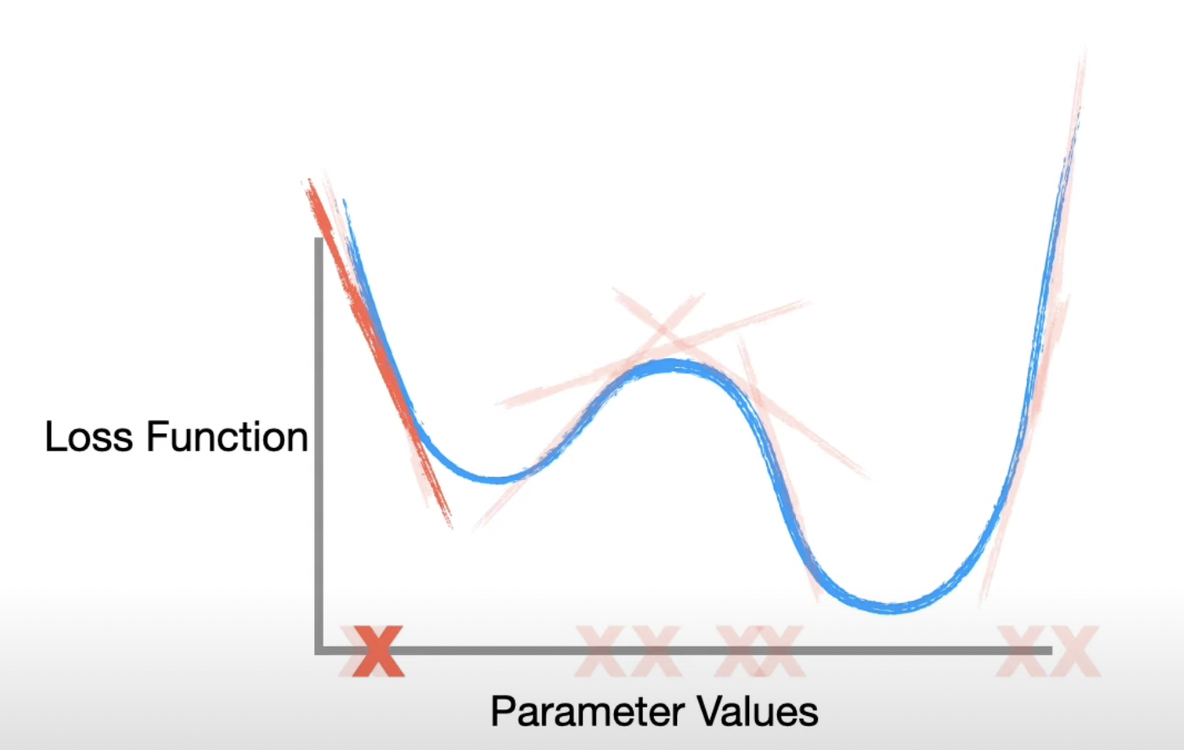
II.A.3 RNN
RNN limitations: Exploding / Vanishing gradient problem
“The”
“transformers”
“are”
“encoder”
“decoder”
“Models” ?
StatQuest with Josh Starmer Youtube
Notes:
W2 = 2
Input x 2 x 2 x 2 x 2 par couche
Input x 16
Quand on met a jour les poids en backpropagation, les poids recoivent un update proportionnel au gradient with respect to le current poid du timestep
Pour les permiers mots dans notre cas, les poids recoivent un update des tous les poiuds supérieur, à savoir une grosse value.
Le modèle devient instable

Slide 19
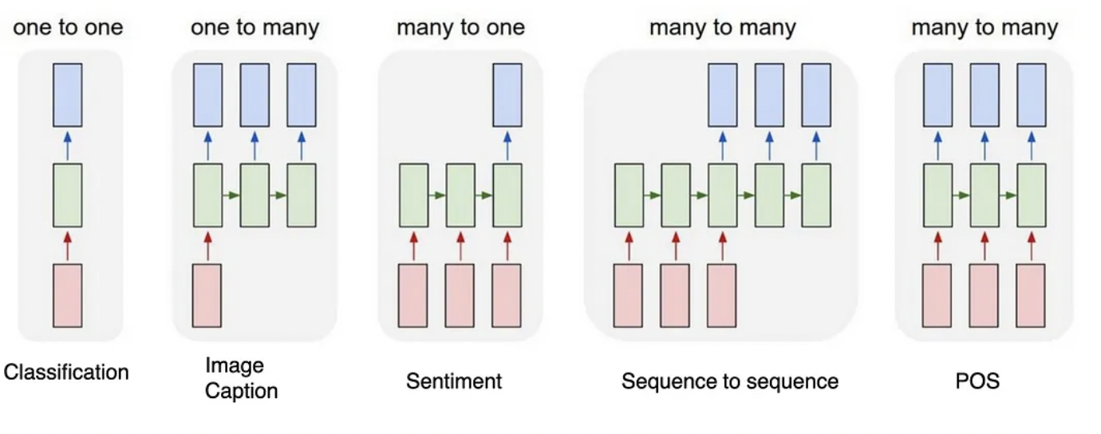
II.A.3 RNN
RNN Types of architectures
“The”
“transformers”
“are”
“encoder”
Q. Which one fit our use case ?
“decoder”
“Models” ?
Praveen Raj, 2023, Understanding Recurrent Neural Networks (RNN) — NLP
StatQuest with Josh Starmer Youtube
Notes:
One to One
This type of RNN behaves the same as any simple Neural network it is also known as Vanilla Neural Network. In this Neural network, there is only one input and one output.
One To Many
In this type of RNN, there is one input and many outputs associated with it. One of the most used examples of this network is Image captioning where given an image we predict a sentence having Multiple words.
Many to One
In this type of network, Many inputs are fed to the network at several states of the network generating only one output. This type of network is used in the problems like sentimental analysis. Where we give multiple words as input and predict only the sentiment of the sentence as output.
Many to Many
In this type of neural network, there are multiple inputs and multiple outputs corresponding to a problem. One Example of this Problem will be language translation. In language translation, we provide multiple words from one language as input and predict multiple words from the second language as output.

Slide 20
II.A.4 LSTM
Our goal today
Input: “Transformers are encoder decoder”
Predict the word “models” from the input sentence
Requirements:
Find a way to transform word into numerical values
Provide semantic relationship between the encoding words
Provide context to our model to understand the sentence
Provide long context to our model to understand the sentence
Create a fast trainable model
Model
Predict: “models”

Slide 21
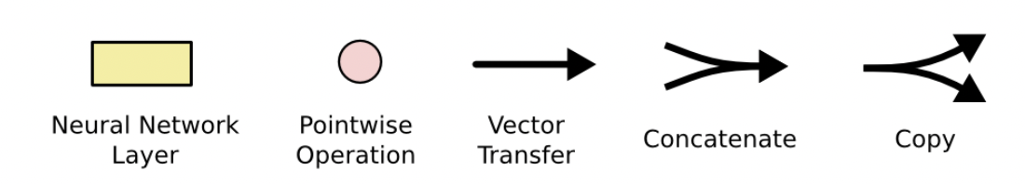
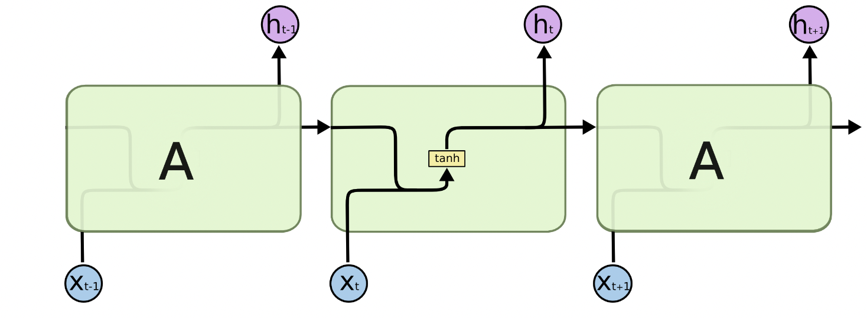
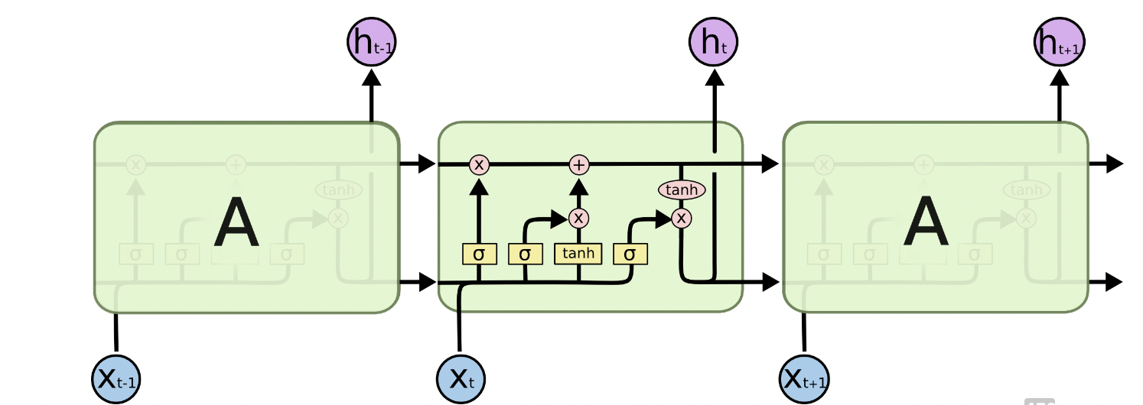
II.A.4 LSTM
Long Short Term Memory (LSTM)
Both long and short term memory are provided
“transformers”
“are”
“encoder”
“transformers”
“are”
“encoder”
RNN architecture
LSTM architecture
Colah, Understanding LSTM Networks [Blog]

Slide 22
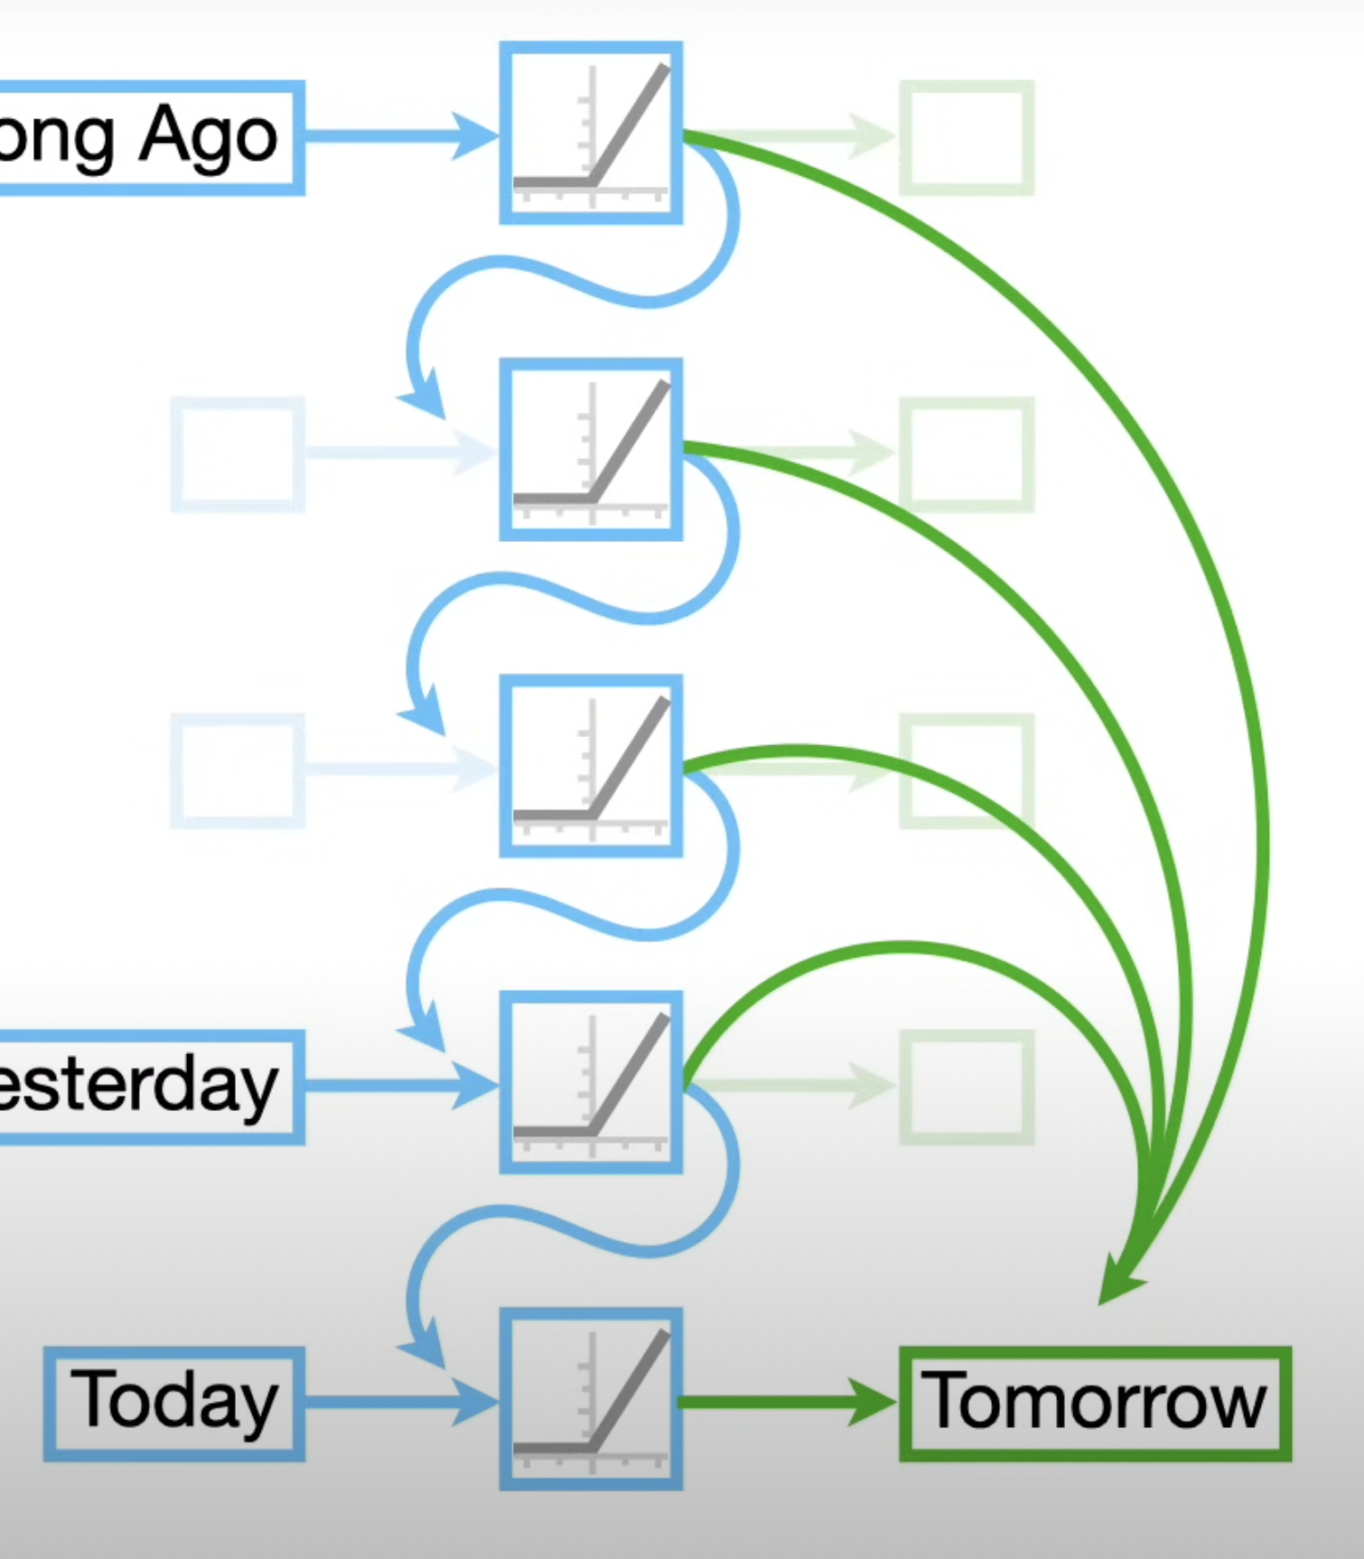
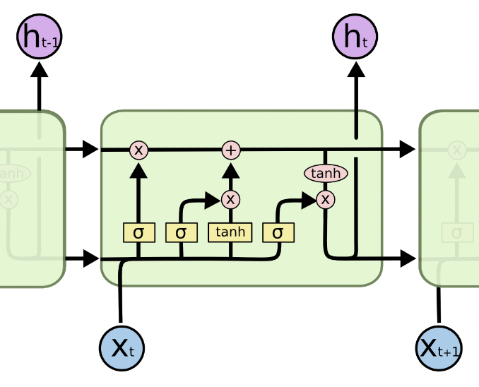
II.A.4 LSTM
Long Short Term Memory (LSTM)
“The”
“transformers”
C_{t-1}
“are”
h_{t-1}
“encoder”
“decoder”
“models”
Colah, Understanding LSTM Networks [Blog]

Slide 23
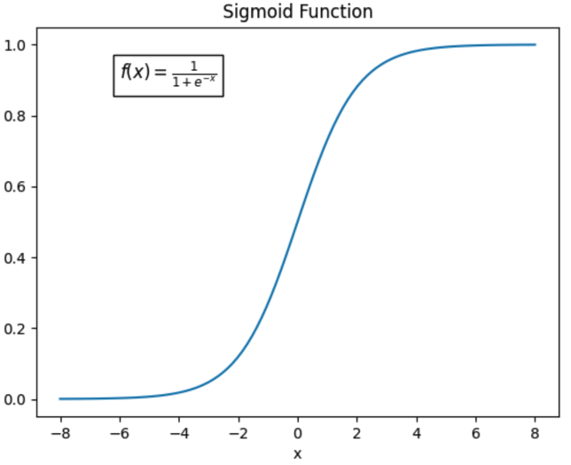
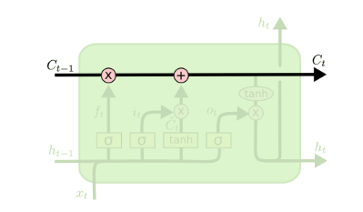
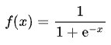
II.A.4 LSTM
Long Short Term Memory (LSTM)
Cell state to propagate long memory
Gate defined by the sigmoid function
0 = don’t pass information
1 = let everything pass through
Colah, Understanding LSTM Networks [Blog]
Notes:
Le LSTM a des gates pour réguler l’information transmise
Grace a une fonction sigmoid définie ici.

Slide 24
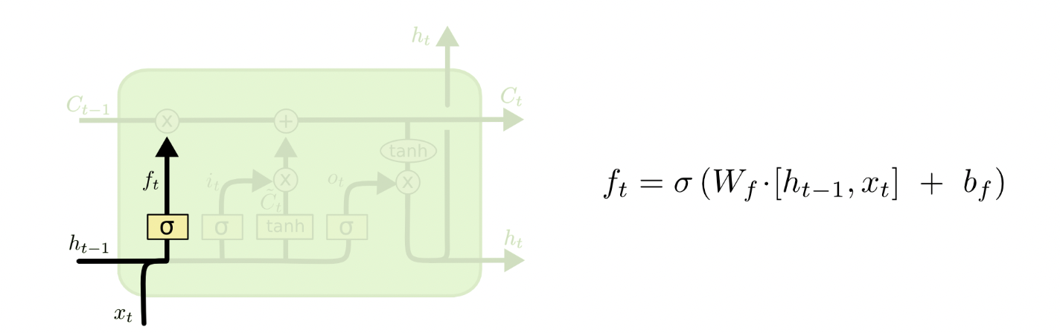
II.A.4 LSTM
Long Short Term Memory (LSTM)
“decoder”
Colah, Understanding LSTM Networks [Blog]
Notes:
La première étape est de savoir ce qui est transmis pour la génération par rapport à l’information passée
La cell state peut contenir le genre, la pluriel du mot à généré par exemple.
Si le mot de cette cellule est un point par exemple, on s’attend a ce que la cell state oublie pas les informations concernant la structure de la phrase par exemple pour que le prochain mot à générer ne soit pas érroné.

Slide 25
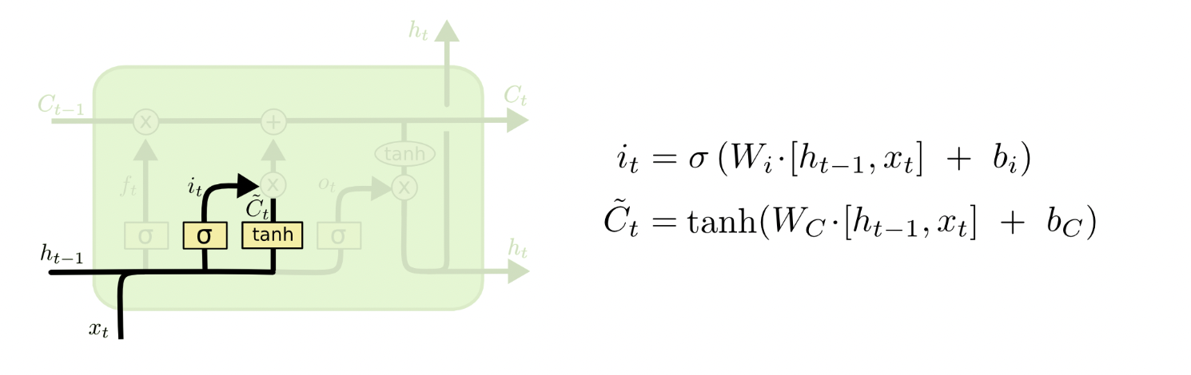
II.A.4 LSTM
Long Short Term Memory (LSTM)
“decoder”
Colah, Understanding LSTM Networks [Blog]
Notes:
Quelle nouvelle information veut on stocker dans le cell state qui représente l’information des anciens mots. On veut populer les informations du nouveaux mots par exemples.
La première porte avec la sigmoid indique quelles informations à conserver
La seconde porte tanh indique doivent être ajouté
Par exemple on va vouloir oublier que le mot a transmettre est un nom et ajouter que le mot insérer est un nom au pluriels.

Slide 26
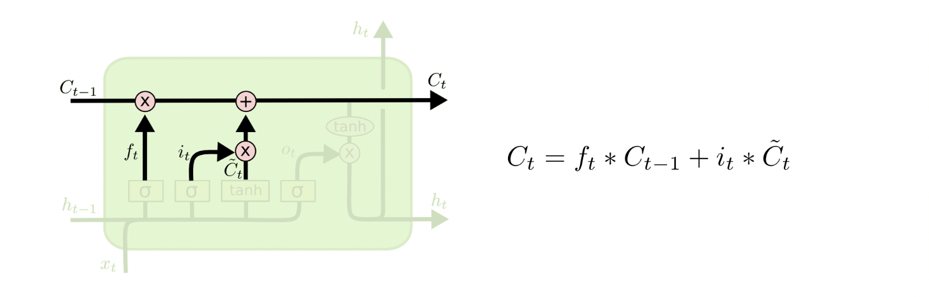
II.A.4 LSTM
Long Short Term Memory (LSTM)
“decoder”
Colah, Understanding LSTM Networks [Blog]
Notes:
On update maintenant le state: avec
F les informations oublié
It les informations modifié
Les nouvelles informations
Ici on va transmettre les informations relative à la génération de notre mot models

Slide 27
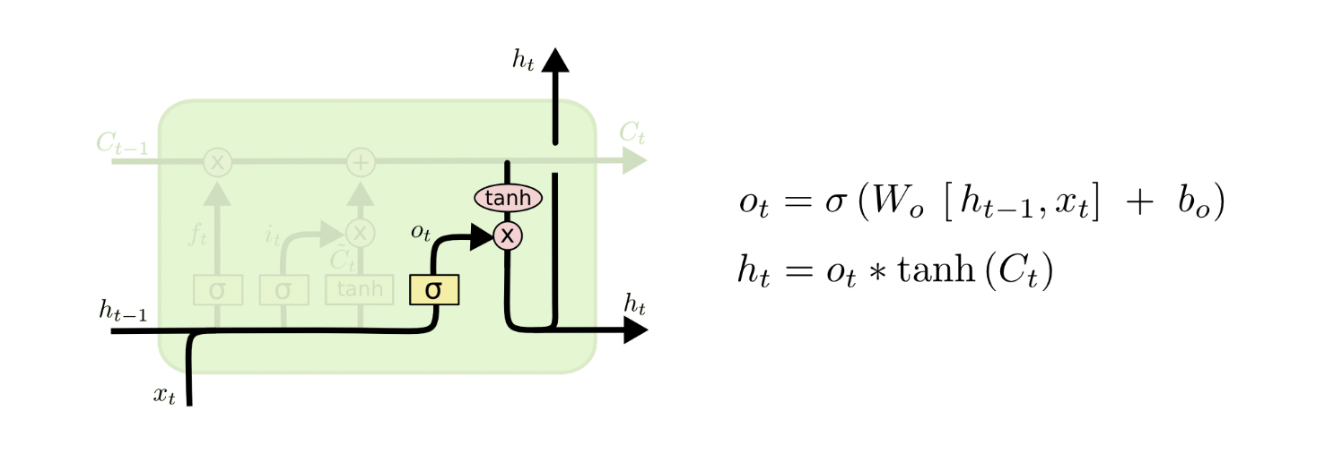
II.A.4 LSTM
Long Short Term Memory (LSTM)
“decoder”
Colah, Understanding LSTM Networks [Blog]
Notes:
Dernière étape, comment représenter le mot qui encode l’existant en se servant des information passé
Decoder ici doit généré un vecteur qui comprendre qu’on parle d’un decoder au sens Transformers et non pas d’un decoder au sens Télévision. Il doit avoir aussi l’information d’un nom. Et aussi l’information que la phrase en au pluriel et impliquera la génération de models et non pas model

Slide 28
II.A.4 LSTM
Long Short Term Memory (LSTM)
What about Vanishing / Exploding Gradients ?
The additive update function for the cell state gives a derivative that is much more ‘well behaved’
The gating functions allow the network to decide how much the gradient vanishes, and can take on different values at each time step. The values that they take on are learned functions of the current input and hidden state.
To get details on LSTM derivative, check out this blog post
Colah, Understanding LSTM Networks [Blog]
Notes:
La gate additive ici ainsi que les gates functions sont des paramètres supplémentaires à optimiser.
Le Modèle comprend de manière autonome que fixer des poids tout le temps haut ou bas entraine le vanishing exploding gradient car la loss est faible.
Il apprend donc a ajuster les autres paramètres du modèle, dont la forget gate pour la gérer

Slide 29
II.A.4 LSTM
Our goal today
Input: “Transformers are encoder decoder”
Predict the word “models” from the input sentence
Requirements:
Find a way to transform word into numerical values
Provide semantic relationship between the encoding words
Provide context to our model to understand the sentence
Provide long context to our model to understand the sentence
Create a fast trainable model
Model
Predict: “models”

